Slide 1
Production of Mabs

Slide 2
Propagation of selected positive clones
Propagation in vivo or ascitic production
10⁶-10⁷ hybridoma cells
are injected IP
pristane-treated
old mice (12-24 weeks)
hybridoma are allowed to grow for 2 weeks.
animals must be compatible with both parent cell lines (Balb/c).
10-60 days before cell injection, pristane injected i.p into adult mice. Why?
Pristane is branched chain alkane which are known to induce myeloma when injected IP.
Pristane acts by severely depressing the normal immunological function of the animal.

Slide 3
Within 2 weeks of cell injection, ascitic fluid 2-5 ml containing 5-15 mg/ml of Mab accumulate in the peritoneum that can be withdrawn with syringe.
Occasionally, solid tumors will develop instead of ascites. This can be overcome by incubating tumor cells in vitro for a few days and then and reinjecting them into pristine-treated animals.
Injecting larger number of cells will cause earlier induction of ascites but it will be more difficult to monitor progress. Sudden unexpected death may occur before ascitic fluid can be harvested .

Slide 4
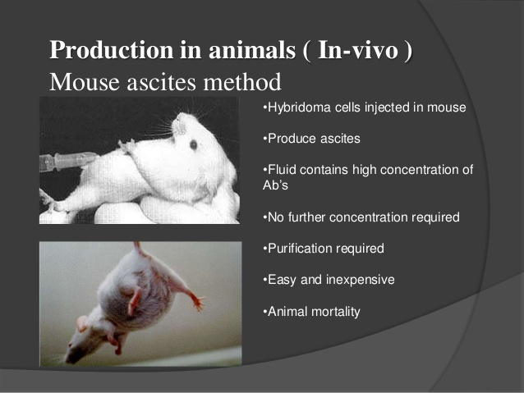

Slide 5
Propagation in vitro
On the lab scale, cells can be grown in stationary culture to produce 5-50 ug/ml
Medium scale: Mabs conc. Of 30 mg/L /day have been achieved in spinner flasks
Industrial large scale production by Hollow fiber bioreactor
--Mammalian cells have more complex nutritional needs and tolerate much lower densities than microbial cultures.
-An increasing popular method of producing high yield of Mab in vitro is to grow hybridoma cells within a hollow fiber reactor.
--The basic principle is that of perfusion of culture medium with necessary CO2 and temp control, through a disposable hollow fiber cartridge which the cells are growing.
-The cartridge is made up of hundreds of hollow fibers of sufficient pore size to allow medium and essential nutrients to pass through the fibers to the extracapillary space containing the growing cells.

Slide 6
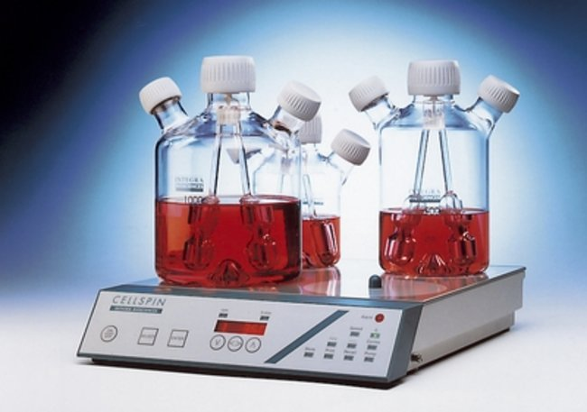
Spinner flasks need semi continuous feeding

Slide 7
Secreted Mabs , which cannot pass through the fiber, are harvested periodically from the extra capillary compartment over the period of months.
It is essential that all cell propagation procedures that the fidelity of the specific Mab productions be monitored regularly. Due to the risk that non-producing revert cells may outgrow the specific Mab-producing cells. This instability varies from cell clone to another. Such instability is not too serious if fresh samples of the clones are available from storage and can be substituted.

Slide 8
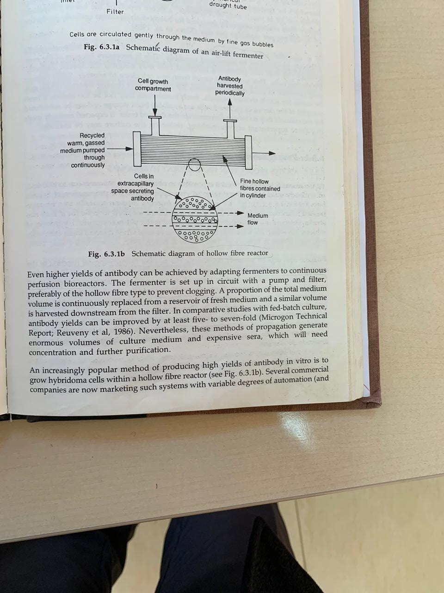

Slide 9
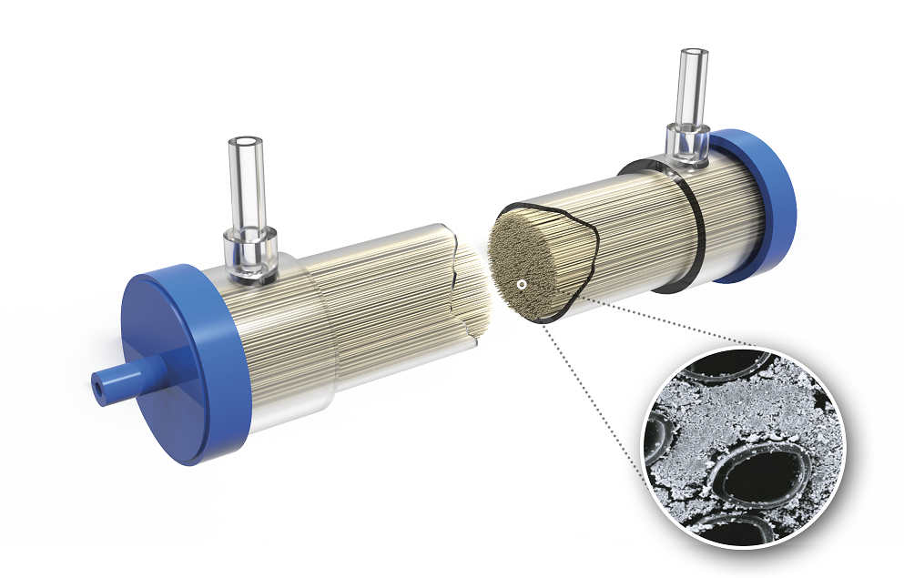
Hollow fiber bioreactor
Harvested Mab
Cell growth
Fine hollow fibers contained in cylinder
Medium flow
Recycled gassed warm media pumped continuously
Cells in Extracapilliary space secreting Mab

Slide 10
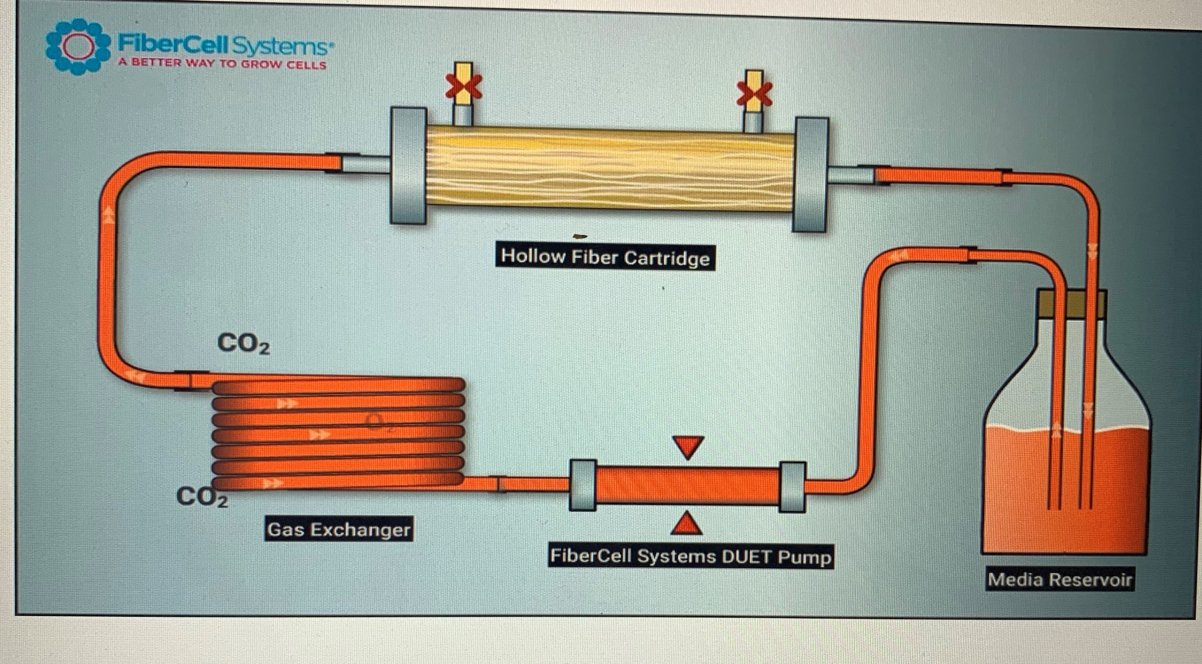

Slide 11
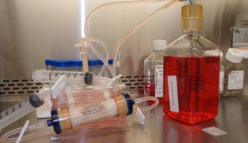

Slide 12
Criteria of Hollow fiber Bioreactor
1. Monoclonal antibody production in the range 50 mg up to Grams
A hollow fiber bioreactor enables large amounts of Mabs to be harvested periodically at high concentrations from cells maintained in continuous high-density culture. The FiberCell System, comprising a pump and cartridges, fits on the shelf of a standard CO2 incubator and within only a few weeks can generate from 50 mg to grams of monoclonal antibody, the amount depending on the time period, clone and cartridge type used.
2. Practical method avoids passaging cells
A standard 20 ml Fiber Cell bioreactor can continuously maintain >= 10⁹ cells at high density over long periods in a standard incubator. The media bottle and cartridge module are in a closed loop that can be readily unclipped from the pump for maintenance in the laminar flow cabinet. Cell mass is controlled during harvesting which means that passaging cells is not required.
3. High titer
High-titer antibodies can be harvested periodically from a FiberCell system using syringes. The FiberCell offers greater oxygenation capacity for even higher levels of production; up to 300mg per week has been reported

Slide 13
4. Elimination of inhibitory TGF-beta from hybridomas
Preventing hybridomas from inhibiting their own productivity
It is often overlooked that hybridomas inhibit their own growth due to the secretion of TGF-Beta which originates from the myeloma cell component. TGF-Beta has a molecular weight of 27 kd and therefore is small enough to diffuse across the fibres of a hollow fibre bioreactor, away from the cells to be diluted in the recirculating media which is periodically replaced with fresh media.
5. Antibody avidity
A hollow fibre bioreactor offers a way to grow cells continuously at densities approaching in-vivo density with very constant pH and continuous elimination of waste metabolites. It’s a reasonable assumption that this mode of culture favours natural enzymatic processing steps leading to native-like post-translational modifications such as glycosylation that can be critical for high antibody avidity.

Slide 14
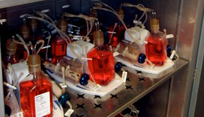
6. Small size
Larger incubators can house up to 6 or more pumps operating simultaneously with higher capacity cartridge types to generate as much as 2 grams per week of a Mab.

Slide 15
7. Purity mAb free of serum
FiberCell recommends exploiting the high cell density conditions offered by this bioreactor to eliminate serum or expensive specialty media by switching to DMEM/10% CDM-HD (CDM-HD Chemically-Defined Serum Replacement for High Density culture is a powder consisting only of low molecular weight, non-animal derived components).

Slide 16
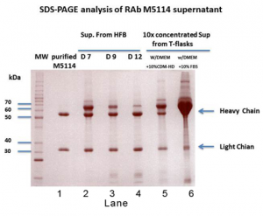
Purity
Lane 1: purified Mab (3 ug)
Lanes 2, 3 and 4: unpurified harvests from the cartridge on day 7, 9 and 12 (2µl)
Lane 5: 10X conc. supernatant from a T-flask using DMEM and 10% CDM-HD (FiberCell) (2µl).
Lane 6: T flask using DMEM and 10% serum (2µl)
Both SDS-PAGE gel and gel filtration analysis showed that the antibody from the hollow fiber bioreactor (HFB) was very clean and properly folded.
Concentration of supernatant from HFB: Approx 2.5 mg/ml.

Slide 17
Mab and COVID-19
Pharmaceutical companies are investigating Mabs as a treatment for COVID-19. Mabs mimic the natural antibodies produced by the body in response to infection and are currently used in the treatment of some cancers.
AstraZeneca has begun an early-stage trial of its antibody based therapeutic for the prevention and treatment of COVID-19. The trial will test if it is safe and tolerable by up to 48 healthy participants in the UK. Regeneron and Roche are also collaborating on clinical trials of their monoclonal antibody treatment (REGN-COV2). REGN-COV2 is currently being studied in two phase 2 trials for the treatment of COVID-19 and a phase 3 trial for the prevention of COVID-19 among household contacts of those infected.

Slide 18
Mab as a business
May 11, 2020 (GLOBE NEWSWIRE) -- The global Mabs therapy market size is projected to reach USD 350 billion by the end of 2027. The increasing prevalence of severe diseases such as cancer will create several opportunities for the companies operating in the market.
According to a report published by Fortune business Insights, titled “Monoclonal Antibody Therapy Market Size, Share & Industry Analysis, the market was worth USD 123 billion in 2019 and will exhibit an increase of 14.0% during the forecast period, 2020-2027.

